Slide 1
DATA MINING LECTURE 4
Frequent Itemsets, Association Rules
Evaluation
Alternative Algorithms

Slide 2
RESULT POST-PROCESSING

Slide 3
Maximal Frequent Itemset
An itemset is maximal frequent if none of its immediate supersets is frequent
Maximal Itemsets
Maximal itemsets = positive border
Infrequent Itemsets
Border
Maximal: no superset has this property

Slide 4
Closed Itemset
An itemset is closed if none of its immediate supersets has the same support as the itemset

Slide 5
Maximal vs Closed Itemsets
Transaction Ids
Not supported by any transactions

Slide 6
Maximal vs Closed Frequent Itemsets
Closed but not maximal
Minimum support = 2
Closed and maximal
# Closed = 9
# Maximal = 4

Slide 7
Maximal vs Closed Itemsets

Slide 8
Pattern Evaluation
Association rule algorithms tend to produce too many rules but many of them are uninteresting or redundant
Redundant if {A,B,C} → {D} and {A,B} → {D} have same support & confidence
Summarization techniques
Uninteresting, if the pattern that is revealed does not offer useful information.
Interestingness measures: a hard problem to define
Interestingness measures can be used to prune/rank the derived patterns
Subjective measures: require human analyst
Objective measures: rely on the data.
In the original formulation of association rules, support & confidence are the only measures used

Slide 9
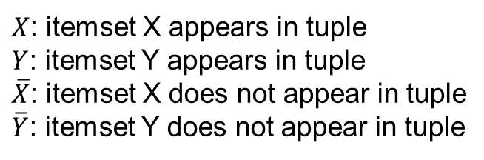
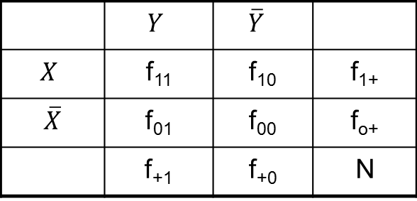
Computing Interestingness Measure
Given a rule X → Y, information needed to compute rule interestingness can be obtained from a contingency table
Contingency table for X → Y
 | $$Y$$ | $$\overline{Y}$$
$$X$$ | f₁₁ | f₁₀ | f₁₊
$\overline{X}$ | f₀₁ | f₀₀ | f_{o+}
 | f₊₁ | f₊₀ | N
f₁₁: support of X and Y f₁₀: support of X and Y f₀₁: support of X and Y f₀₀: support of X and Y
$X$: itemset X appears in tuple
$Y$: itemset Y appears in tuple
$\overline{X}$: itemset X does not appear in tuple
$\overline{Y}$: itemset Y does not appear in tuple
Used to define various measures
support, confidence, lift, Gini, J-measure, etc.

Slide 10
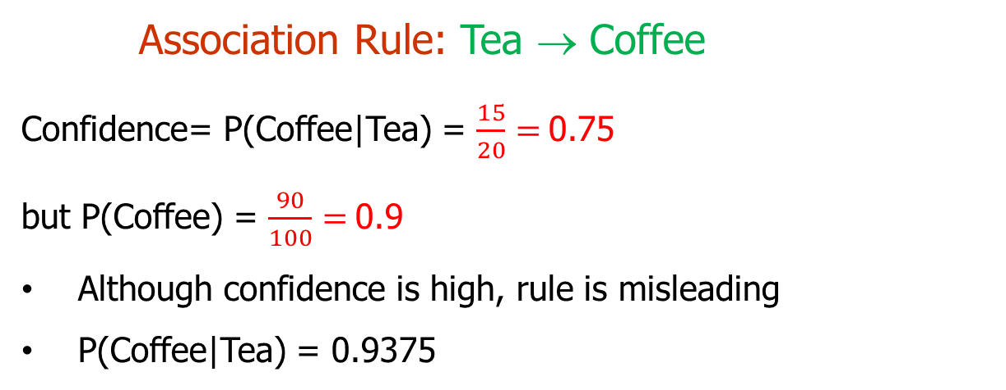
Drawback of Confidence
Number of people that drink tea
 | Coffee | Coffee
Tea | 15 | 5 | 20
Tea | 75 | 5 | 80
 | 90 | 10 | 100
Number of people that drink coffee and tea
Number of people that drink coffee but not tea
Number of people that drink coffee
Association Rule: Tea → Coffee
Confidence= P(Coffee|Tea) = $\frac{15}{20}=$0.75
but P(Coffee) = $\frac{90}{100}=$0.9
Although confidence is high, rule is misleading
P(Coffee|Tea) = 0.9375

Slide 11
Statistical Independence
Population of 1000 students
600 students know how to swim (S)
700 students know how to bike (B)
420 students know how to swim and bike (S,B)
P(S∧B) = 420/1000 = 0.42
P(S) × P(B) = 0.6 × 0.7 = 0.42
P(S∧B) = P(S) × P(B) => Statistical independence

Slide 12
Statistical Independence
Population of 1000 students
600 students know how to swim (S)
700 students know how to bike (B)
500 students know how to swim and bike (S,B)
P(S∧B) = 500/1000 = 0.5
P(S) × P(B) = 0.6 × 0.7 = 0.42
P(S∧B) > P(S) × P(B) => Positively correlated

Slide 13
Statistical Independence
Population of 1000 students
600 students know how to swim (S)
700 students know how to bike (B)
300 students know how to swim and bike (S,B)
P(S∧B) = 300/1000 = 0.3
P(S) × P(B) = 0.6 × 0.7 = 0.42
P(S∧B) < P(S) × P(B) => Negatively correlated

Slide 14
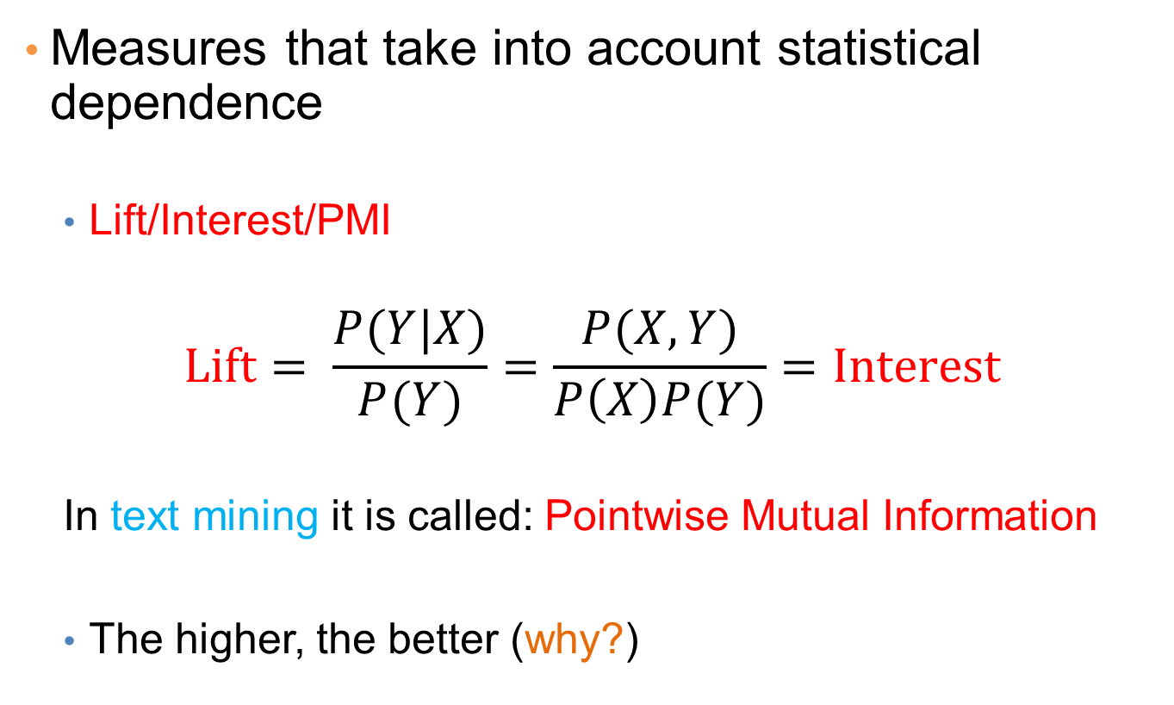
Statistical-based Measures
Measures that take into account statistical dependence
Lift/Interest/PMI
$$Lift= \frac{P(Y|X)}{P(Y)}=\frac{P(X,Y)}{P\left(X\right)P(Y)}=Interest$$
In text mining it is called: Pointwise Mutual Information
The higher, the better (why?)

Slide 15
Example: Lift/Interest
 | Coffee | Coffee
Tea | 15 | 5 | 20
Tea | 75 | 5 | 80
 | 90 | 10 | 100
Association Rule: Tea → Coffee
Confidence= P(Coffee|Tea) = 0.75
but P(Coffee) = 0.9
Lift = 0.75/0.9= 0.8333 (< 1, therefore is negatively associated)
= 0.15/(0.9*0.2)

Slide 16
THE FP-TREE AND THE FP-GROWTH ALGORITHM
Slides from course lecture of E. Pitoura

Slide 17
Overview
The FP-tree contains a compressed representation of the transaction database.
A trie (prefix-tree) data structure is used
Each transaction is a path in the tree – paths can overlap.
Once the FP-tree is constructed the recursive, divide-and-conquer FP-Growth algorithm is used to enumerate all frequent itemsets.

Slide 18
FP-tree Construction
The FP-tree is a trie (prefix tree)
Since transactions are sets of items, we need to transform them into ordered sequences so that we can have prefixes
Otherwise, there is no common prefix between sets {A,B} and {B,C,A}
We need to impose an order to the items
Initially, assume a lexicographic order.

Slide 19
FP-tree Construction
Initially the tree is empty
null

Slide 20
FP-tree Construction
Reading transaction TID = 1
Each node in the tree has a label consisting of the item and the support (number of transactions that reach that node, i.e. follow that path)
null
A:1
B:1
Node label = item:support

Slide 21
FP-tree Construction
Reading transaction TID = 2
We add pointers between nodes that refer to the same item
null
A:1
B:1
B:1
C:1
D:1
Each transaction is a path in the tree

Slide 22
FP-tree Construction
null
After reading transactions TID=1, 2:
A:1
B:1
B:1
C:1
Header Table
D:1
The Header Table and the pointers assist in computing the itemset support

Slide 23
FP-tree Construction
null
Reading transaction TID = 3
A:1
A:1
B:1
B:1
C:1
D:1

Slide 24
FP-tree Construction
null
Reading transaction TID = 3
A:2
B:1
B:1
C:1
C:1
D:1
D:1
E:1

Slide 25
FP-tree Construction
null
Reading transaction TID = 3
A:2
B:1
B:1
C:1
C:1
D:1
D:1
E:1
Each transaction is a path in the tree

Slide 26
FP-Tree Construction
Transaction Database
Each transaction is a path in the tree
null
A:7
B:3
B:5
C:3
C:1
D:1
E:1
Header table
D:1
C:3
D:1
E:1
D:1
E:1
D:1
Pointers are used to assist frequent itemset generation

Slide 27
FP-tree size
Every transaction is a path in the FP-tree
The size of the tree depends on the compressibility of the data
Extreme case: All transactions are the same, the FP-tree is a single branch
Extreme case: All transactions are different the size of the tree is the same as that of the database (bigger actually since we need additional pointers)

Slide 28
Item ordering
The size of the tree also depends on the ordering of the items.
Heuristic: order the items in according to their frequency from larger to smaller.
We would need to do an extra pass over the dataset to count frequencies
Example:
TID
Items
σ(Α)=7, σ(Β)=8, σ(C)=7, σ(D)=5, σ(Ε)=3
Ordering : Β,Α,C,D,E
1
{Β,Α}
2
{B,C,D}
3
{A,C,D,E}
4
{A,D,E}
5
{Β,Α,C}
6
{Β,Α,C,D}
7
{B,C}
8
{Β,Α,C}
9
{Β,Α,D}
10
{B,C,E}

Slide 29
Finding Frequent Itemsets
Input: The FP-tree
Output: All Frequent Itemsets and their support
Method:
Divide and Conquer:
Consider all itemsets that end in: E, D, C, B, A
For each possible ending item, consider the itemsets with last items one of items preceding it in the ordering
E.g, for E, consider all itemsets with last item D, C, B, A. This way we get all the itesets ending at DE, CE, BE, AE
Proceed recursively this way.
Do this for all items.

Slide 30
Frequent itemsets
All Itemsets
Ε D C B A
DE CE BE AE
CD BD AD
BC AC
AB
CDE BDE ADE
BCE ACE
ABE
BCD ACD
ABD
ABC
ACDE BCDE
ABDE
ABCE
ABCD
ABCDE

Slide 31
Frequent Itemsets
All Itemsets
Ε D C B A
Frequent?;
DE CE BE AE
CD BD AD
BC AC
AB
Frequent?;
CDE BDE ADE
BCE ACE
ABE
BCD ACD
ABD
ABC
Frequent?
ACDE BCDE
ABDE
ABCE
ABCD
Frequent?
ABCDE

Slide 32
Frequent Itemsets
All Itemsets
Ε D C B A
Frequent?
DE CE BE AE
CD BD AD
BC AC
AB
Frequent?
CDE BDE ADE
BCE ACE
ABE
BCD ACD
ABD
ABC
Frequent?
Frequent?
ACDE BCDE
ABDE
ABCE
ABCD
Frequent?
ABCDE

Slide 33
Frequent Itemsets
All Itemsets
Ε D C B A
Frequent?
DE CE BE AE
CD BD AD
BC AC
AB
Frequent?
CDE BDE ADE
BCE ACE
ABE
BCD ACD
ABD
ABC
Frequent?
ACDE BCDE
ABDE
ABCE
ABCD
ABCDE
We can generate all itemsets this way
We expect the FP-tree to contain a lot less

Slide 34
Using the FP-tree to find frequent itemsets
Transaction Database
null
A:7
B:3
B:5
C:3
C:1
D:1
E:1
Header table
D:1
C:3
D:1
E:1
D:1
E:1
D:1
Bottom-up traversal of the tree.
First, itemsets ending in E, then D, etc, each time a suffix-based class

Slide 35
Finding Frequent Itemsets
null
Subproblem: find frequent itemsets ending in E
A:7
B:3
B:5
C:3
C:1
D:1
Header table
D:1
C:3
D:1
E:1
E:1
D:1
E:1
D:1
We will then see how to compute the support for the possible itemsets

Slide 36
Finding Frequent Itemsets
null
Ending in D
A:7
B:3
B:5
C:3
C:1
D:1
Header table
D:1
C:3
D:1
E:1
E:1
D:1
E:1
D:1

Slide 37
Finding Frequent Itemsets
null
Ending in C
A:7
B:3
B:5
C:3
C:1
D:1
Header table
D:1
C:3
D:1
E:1
E:1
D:1
E:1
D:1

Slide 38
Finding Frequent Itemsets
null
Ending in B
A:7
B:3
B:5
C:3
C:1
D:1
Header table
D:1
C:3
D:1
E:1
E:1
D:1
E:1
D:1

Slide 39
Finding Frequent Itemsets
null
Ending in Α
A:7
B:3
B:5
C:3
C:1
D:1
Header table
D:1
C:3
D:1
E:1
E:1
D:1
E:1
D:1

Slide 40
Algorithm
For each suffix X
Phase 1
Construct the prefix tree for X as shown before, and compute the support using the header table and the pointers
Phase 2
If X is frequent, construct the conditional FP-tree for X in the following steps
Recompute support
Prune infrequent items
Prune leaves and recurse

Slide 41
Example
null
Phase 1 – construct prefix tree
Find all prefix paths that contain E
A:7
B:3
B:5
C:3
C:1
D:1
Header table
D:1
C:3
D:1
E:1
E:1
D:1
E:1
D:1
Suffix Paths for Ε:
{A,C,D,E}, {A,D,Ε}, {B,C,E}

Slide 42
Example
null
Phase 1 – construct prefix tree
Find all prefix paths that contain E
A:7
B:3
C:3
C:1
D:1
D:1
E:1
E:1
E:1
Prefix Paths for Ε:
{A,C,D,E}, {A,D,Ε}, {B,C,E}

Slide 43
Example
null
Compute Support for E (minsup = 2)
How?
Follow pointers while summing up counts: 1+1+1 = 3 > 2
E is frequent
A:7
B:3
C:3
C:1
D:1
D:1
E:1
E:1
E:1
{E} is frequent so we can now consider suffixes DE, CE, BE, AE

Slide 44
Example
null
E is frequent so we proceed with Phase 2
Phase 2
Convert the prefix tree of E into a conditional FP-tree
Two changes
(1) Recompute support
(2) Prune infrequent
A:7
B:3
C:3
C:1
D:1
D:1
E:1
E:1
E:1

Slide 45
Example
null
Recompute Support
A:7
B:3
The support counts for some of the nodes include transactions that do not end in E
For example in null->B->C->E we count {B, C}
The support of any node is equal to the sum of the support of leaves with label E in its subtree
C:3
C:1
D:1
D:1
E:1
E:1
E:1

Slide 46
Example
null
A:7
B:3
C:3
C:1
D:1
D:1
E:1
E:1
E:1

Slide 47
Example
null
A:7
B:3
C:1
C:1
D:1
D:1
E:1
E:1
E:1

Slide 48
Example
null
A:7
B:1
C:1
C:1
D:1
D:1
E:1
E:1
E:1

Slide 49
Example
null
A:7
B:1
C:1
C:1
D:1
D:1
E:1
E:1
E:1

Slide 50
Example
null
A:7
B:1
C:1
C:1
D:1
D:1
E:1
E:1
E:1

Slide 51
Example
null
A:2
B:1
C:1
C:1
D:1
D:1
E:1
E:1
E:1

Slide 52
Example
null
A:2
B:1
C:1
C:1
D:1
D:1
E:1
E:1
E:1

Slide 53
Example
null
A:2
B:1
Truncate
Delete the nodes of Ε
C:1
C:1
D:1
D:1
E:1
E:1
E:1

Slide 54
Example
null
A:2
B:1
Truncate
Delete the nodes of Ε
C:1
C:1
D:1
D:1
E:1
E:1
E:1

Slide 55
Example
null
A:2
B:1
Truncate
Delete the nodes of Ε
C:1
C:1
D:1
D:1

Slide 56
Example
null
A:2
B:1
Prune infrequent
In the conditional FP-tree some nodes may have support less than minsup
e.g., B needs to be pruned
This means that B appears with E less than minsup times
C:1
C:1
D:1
D:1

Slide 57
Example
null
A:2
B:1
C:1
C:1
D:1
D:1

Slide 58
Example
null
A:2
C:1
C:1
D:1
D:1

Slide 59
Example
null
A:2
C:1
C:1
D:1
D:1
The conditional FP-tree for E
Repeat the algorithm for {D, E}, {C, E}, {A, E}

Slide 60
Example
null
A:2
C:1
C:1
D:1
D:1
Phase 1
Find all prefix paths that contain D (DE) in the conditional FP-tree

Slide 61
Example
null
A:2
C:1
D:1
D:1
Phase 1
Find all prefix paths that contain D (DE) in the conditional FP-tree

Slide 62
Example
null
A:2
C:1
D:1
D:1
Compute the support of {D,E} by following the pointers in the tree
1+1 = 2 ≥ 2 = minsup
{D,E} is frequent

Slide 63
Example
null
A:2
C:1
D:1
D:1
Phase 2
Construct the conditional FP-tree
Recompute Support
Prune nodes

Slide 64
Example
null
A:2
Recompute support
C:1
D:1
D:1

Slide 65
Example
null
A:2
Prune nodes
C:1
D:1
D:1

Slide 66
Example
null
A:2
Prune nodes
C:1

Slide 67
Example
null
A:2
Prune nodes
C:1
Small support

Slide 68
Example
null
A:2
Final condition FP-tree for {D,E}
The support of A is ≥ minsup so {A,D,E} is frequent
Since the tree has a single node we return to the next subproblem

Slide 69
Example
null
A:2
C:1
C:1
D:1
D:1
The conditional FP-tree for E
We repeat the algorithm for {D,E}, {C,E}, {A,E}

Slide 70
Example
null
A:2
C:1
C:1
D:1
D:1
Phase 1
Find all prefix paths that contain C (CE) in the conditional FP-tree

Slide 71
Example
null
A:2
C:1
C:1
Phase 1
Find all prefix paths that contain C (CE) in the conditional FP-tree

Slide 72
Example
null
A:2
C:1
C:1
Compute the support of {C,E} by following the pointers in the tree
1+1 = 2 ≥ 2 = minsup
{C,E} is frequent

Slide 73
Example
null
A:2
C:1
C:1
Phase 2
Construct the conditional FP-tree
Recompute Support
Prune nodes

Slide 74
Example
null
A:1
C:1
Recompute support
C:1

Slide 75
Example
null
A:1
C:1
Prune nodes
C:1

Slide 76
Example
null
A:1
Prune nodes

Slide 77
Example
null
A:1
Prune nodes

Slide 78
Example
null
Prune nodes
Return to the previous subproblem

Slide 79
Example
null
A:2
C:1
C:1
D:1
D:1
The conditional FP-tree for E
We repeat the algorithm for {D,E}, {C,E}, {A,E}

Slide 80
Example
null
A:2
C:1
C:1
D:1
D:1
Phase 1
Find all prefix paths that contain A (AE) in the conditional FP-tree

Slide 81
Example
null
A:2
Phase 1
Find all prefix paths that contain A (AE) in the conditional FP-tree

Slide 82
Example
null
A:2
Compute the support of {A,E} by following the pointers in the tree
2 ≥ minsup
{A,E} is frequent
There is no conditional FP-tree for {A,E}

Slide 83
Example
So for E we have the following frequent itemsets
{E}, {D,E}, {C,E}, {A,E}
We proceed with D

Slide 84
Example
null
Ending in D
A:7
B:3
B:5
C:3
C:1
D:1
Header table
D:1
C:3
D:1
E:1
E:1
D:1
E:1
D:1

Slide 85
Example
null
Phase 1 – construct prefix tree
Find all prefix paths that contain D
Support 5 > minsup, D is frequent
Phase 2
Convert prefix tree into conditional FP-tree
A:7
B:3
B:5
C:3
C:1
D:1
D:1
C:3
D:1
D:1
D:1

Slide 86
Example
null
A:7
B:3
B:5
C:3
C:1
D:1
D:1
C:1
D:1
D:1
D:1
Recompute support

Slide 87
Example
null
A:7
B:3
B:2
C:3
C:1
D:1
D:1
C:1
D:1
D:1
D:1
Recompute support

Slide 88
Example
null
A:3
B:3
B:2
C:3
C:1
D:1
D:1
C:1
D:1
D:1
D:1
Recompute support

Slide 89
Example
null
A:3
B:3
B:2
C:1
C:1
D:1
D:1
C:1
D:1
D:1
D:1
Recompute support

Slide 90
Example
null
A:3
B:1
B:2
C:1
C:1
D:1
D:1
C:1
D:1
D:1
D:1
Recompute support

Slide 91
Example
null
A:3
B:1
B:2
C:1
C:1
D:1
D:1
C:1
D:1
D:1
D:1
Prune nodes

Slide 92
Example
null
A:3
B:1
B:2
C:1
C:1
C:1
Prune nodes

Slide 93
Example
null
A:3
B:1
B:2
C:1
C:1
C:1
Construct conditional FP-trees for {C,D}, {B,D}, {A,D}
And so on….

Slide 94
Observations
At each recursive step we solve a subproblem
Construct the prefix tree
Compute the new support
Prune nodes
Subproblems are disjoint so we never consider the same itemset twice
Support computation is efficient – happens together with the computation of the frequent itemsets.

Slide 95
Observations
The efficiency of the algorithm depends on the compaction factor of the dataset
If the tree is bushy then the algorithm does not work well, it increases a lot of number of subproblems that need to be solved.

